Slide 1
Syphone: CLV Case Analysis
By Group 2

Slide 2
Case Background
SyPhone is a cell phone company that specializes in providing cell phone contracts to small to medium-sized businesses,with inclusive services like equipment, support, maintenance, and unlimited.
They operate in a highly competitive B2B market where price sensitivity is balanced with a high demand for quality service.
Historical data suggests that customers who received larger discounts tend to have lower short-term profitability but exhibit higher long-term loyalty.
Notes:
Add in background -Nanditha

Slide 3
Customer Segments
Two Key Account Types:
Large accounts represent contracts that cover between 100 and 500 cell phones. A contract of 500 cell phones is pretty large for a small company like SyPhone; a large account covers about 150 cell phones on average.
Small accounts represent contracts that cover between 5 and 100 cell phones. A small account covers about 20 cell phones on average. When negotiating contracts, some customers receive bigger discounts than others. For simplicity, they may be
Grouped into two subgroups:
No rebate customers pay $100 per month per user. This price includes phone equipment, support, service, maintenance, and unlimited calling.
Rebate customers pay about $80 per month per user for the same service.
Notes:
-Nanditha

Slide 4
Telecommunications Industry
Telecommunication providers operate in a competitive B2B market where pricing sensitivity creates a challenging landscape.
Customer retention is facilitated by significant barriers, such as equipment changes and user retraining, but contract expirations can prompt customer churn.
SyPhone's strategic focus includes assessing customer profitability for both contract renewals and new customer acquisitions, underlining the importance of data-driven decision-making.

Slide 5
Data Exploration and Analysis Conducted
Monte Carlo Simulation and Probability: We used these methods to calculate customer expected value.
Behavior Analysis: Customer behavior evolution guided our value predictions.
Long-Term Revenue Forecast: A 10-year revenue forecast was made using a spreadsheet.
Notes:
In this case we used simulation and probability to compute expected value of customers. To conduct this analysis we used past customer sales data to create a transition matrix to quantify how a current customer evolves. Once you know how your customer behaves you can use probability distribution and simulation to predict how much value a customer will bring based on how much they typically spend. After we get a rough idea of how much revenue an average customer bring we used a spreadsheet to sum the amount we expect to make in a 10 year period

Slide 6
Transition Matrix
The transition matrix is a useful tool for firms to track the evolution of their customers.
It identifies three key behaviors:
Some customers remain active without changes.
Some stay active but re-negotiate for better terms.
Others terminate contracts, contributing to the churn rate.

Slide 7
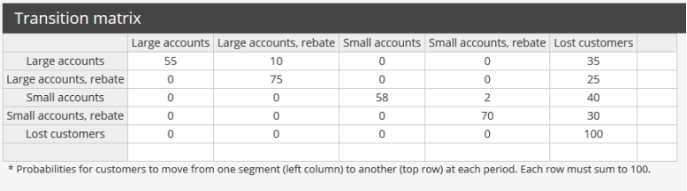
Transition Matrix

Slide 8
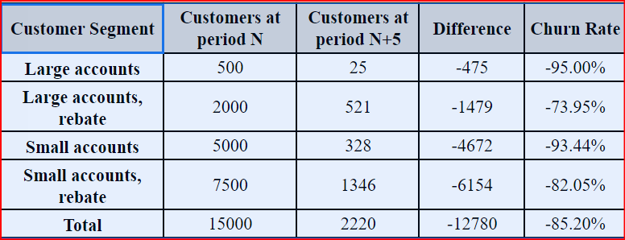
Of the 15,000 customers SyPhone has today, how many will still be SyPhone customers in five years?
Notes:
Jeevan
In five years, Syphone will only have 2220 of its original 15000 accounts, resulting in a churn 85.20%
After five years, of the original 500 Large accounts, only 25 accounts remain, resulting in a churn rate of 95.00%.
For large accounts with rebates 25% will remain. From all four of the different segments it seems that large accounts with rebates will have the most remaining accounts. With that said I would focus some attention on maintaining that customer, but overall I would recommend that more money be allocated toward marketing to acquire more customers but to plan to only keep customers for a short period of time.
After five years, of the original 2000 Large accounts, rebate, only 521 accounts remain, resulting in a churn rate of 73.95%.
After five years, of the original 5000 Small accounts, only 328 accounts remain, resulting in a churn rate of 93.44%.
After five years, of the original 7500 Small accounts, rebate, only 1346 accounts remain, resulting in a churn rate of 82.05%.
From this analysis we noted that across all customer segments, the churn rates are quite high, ranging from 73.95% to 95.00%. Large Accounts with Rebates saw a relatively low churn rate at 73.95% which was 21 basis points lower than Large accounts without rebates at 95% churn. This could suggest that offering rebates to customers may aid in customer retention. We can see a similar pattern amongst Small Accounts, with Rebate accounts churning less over five years than their NonRebate counterparts with an 11.39 basis point difference from 93.44% to 82.05%. Overall the Churn rate for Syphone over five years was 85.2% indicating that serious effort should be made to create and implement customer retention strategies.

Slide 9
Customer Base Valuation Analysis
Churn Rates Across Customer Segments:
Churn rates range from 73.95% to 95.00% across all customer segments.
Large Accounts with Rebates exhibit a lower churn rate of 73.95%, compared to 95% for Large Accounts without rebates.
Impact of Offering Rebates:
Offering rebates to customers may aid in customer retention, as indicated by the 21 basis point lower churn rate among Large Accounts with Rebates.
Small Accounts and Rebates:
Similar patterns emerge in Small Accounts, with Rebate accounts showing an 11.39 basis point lower churn rate (82.05%) compared to NonRebate counterparts (93.44%).
Notes:
Jeevan

Slide 10
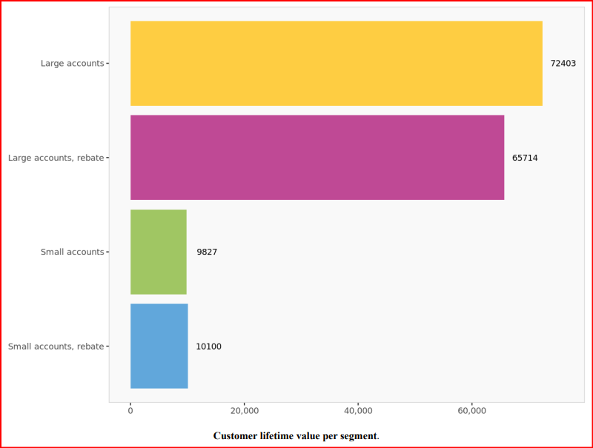
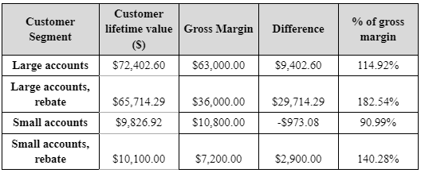
What is the lifetime value of a typical customer in each of the four segments?
Using A discount rate of 10%
.
Notes:
In this case we used simulation and expected value to help us predict how our customers and expected value will evolve, and using that we were able to estimate the Customer Lifetime value. Seems Like large accounts have a significantly Larger CLV.

Slide 11
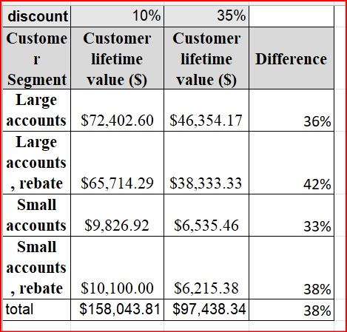
How does an increase of the discount factor change the CLV analysis?
Discount factor increased from 10% to 35%
Notes:
Adrian
A higher discount factor significantly decreases the overall CLV. This means that management does not believe the clv accurately reflects the absolute value of the model because you can't count on customer behavior data to forecast the income of company that is in a highly volatile industry that is rapidly changing. Based on how management increases discount to 35% this I would say Syphon believes money today is more valuable than money tomorrow because anything could change the value that a customer bring such as recession or they could decide to churn to a new company. Also their technology could change making their product obsolete

Slide 12
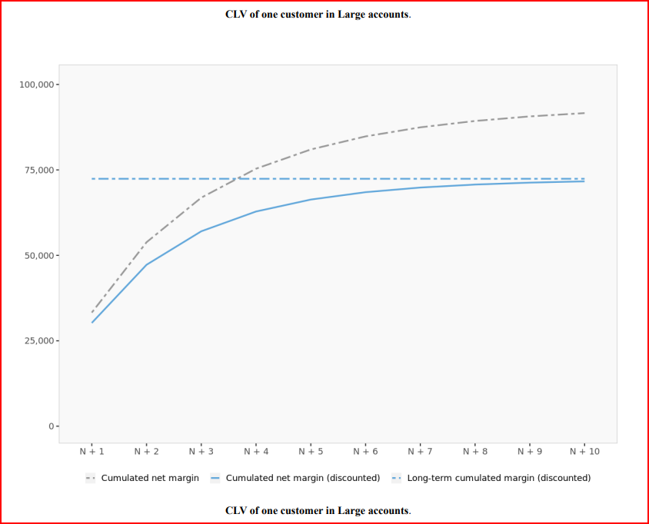
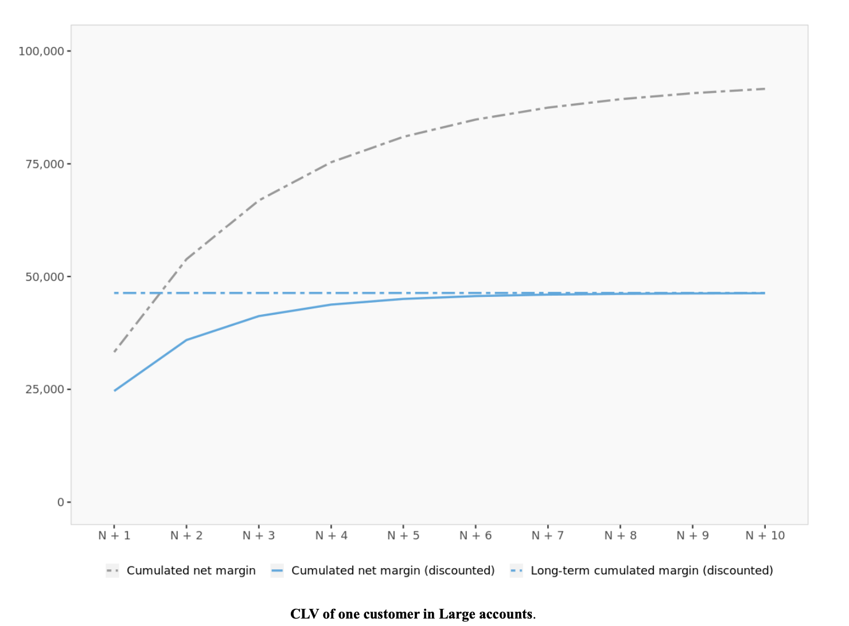
CLV of One Large Accounts (10% vs 35% discount)
Notes:
Adrian

Slide 13
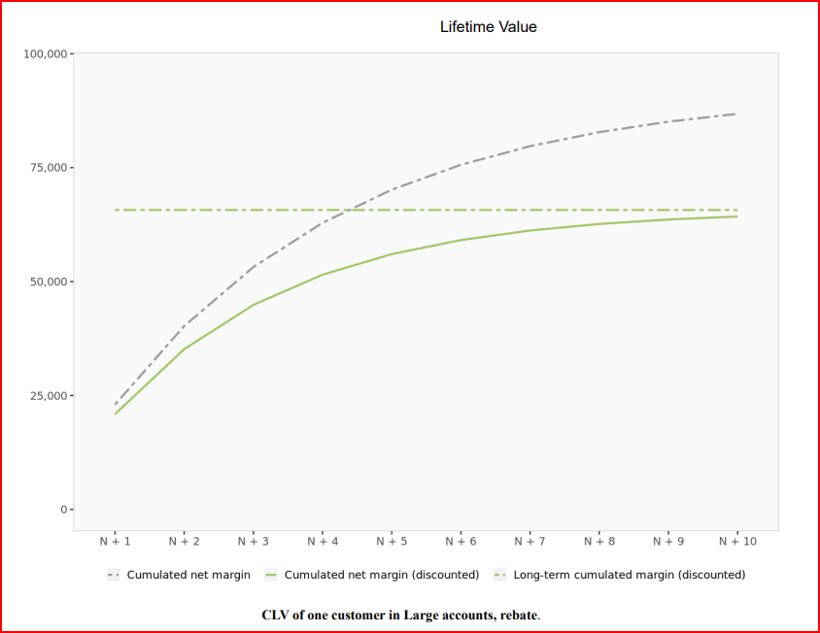
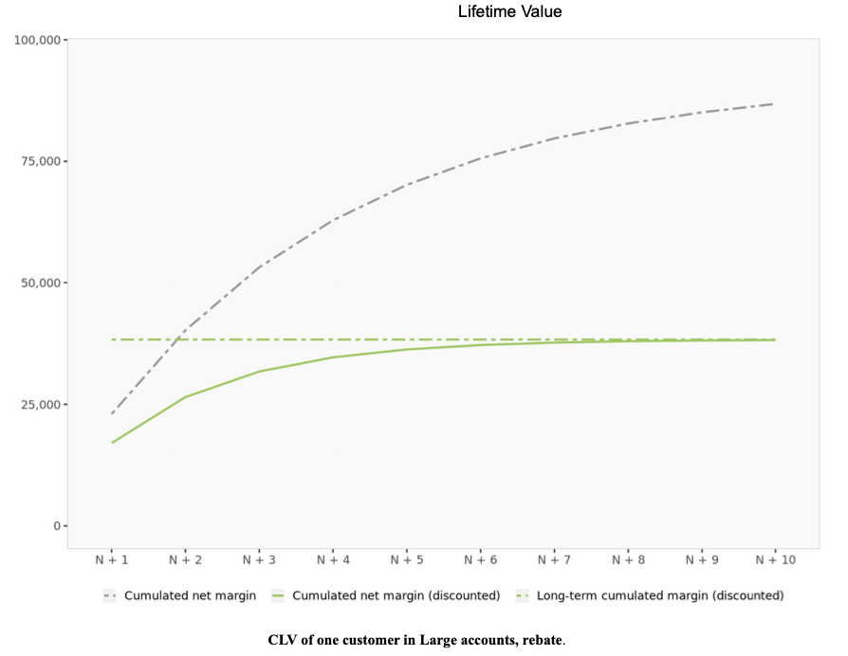
CLV of One Large Accounts w/ Rebates (10% vs 35% discount)
Notes:
Adrian

Slide 14
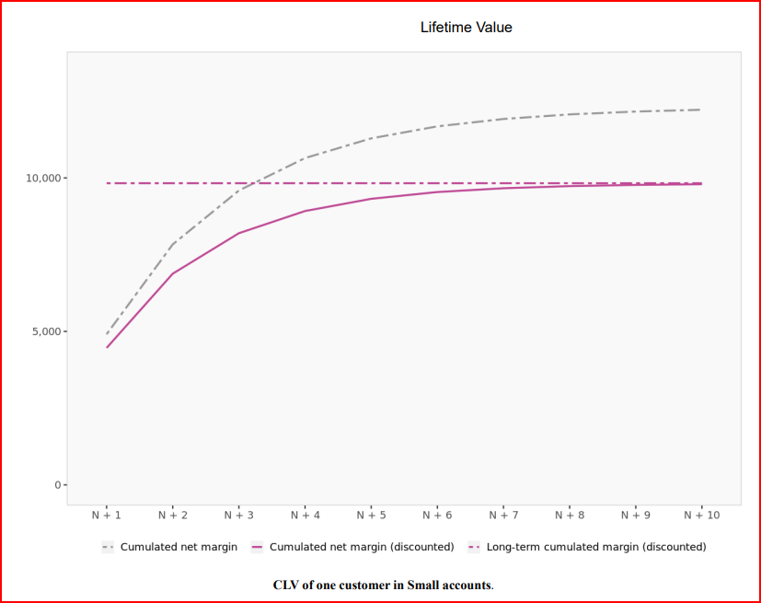
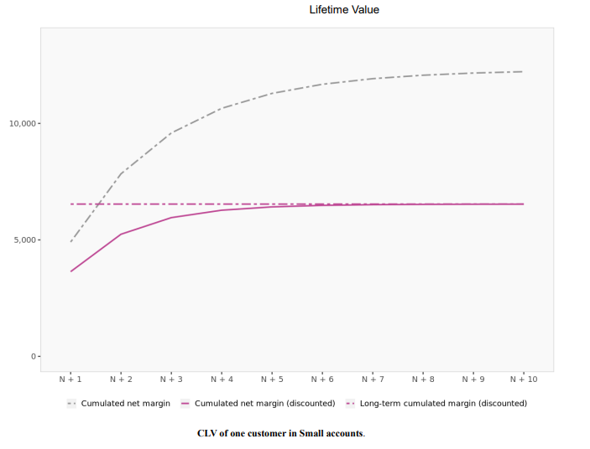
CLV of One Small Accounts (10% vs 35% discount)
Notes:
Adrian

Slide 15
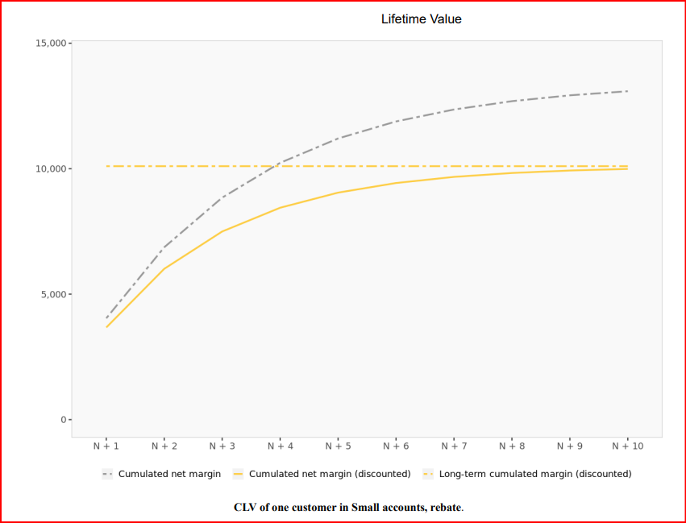
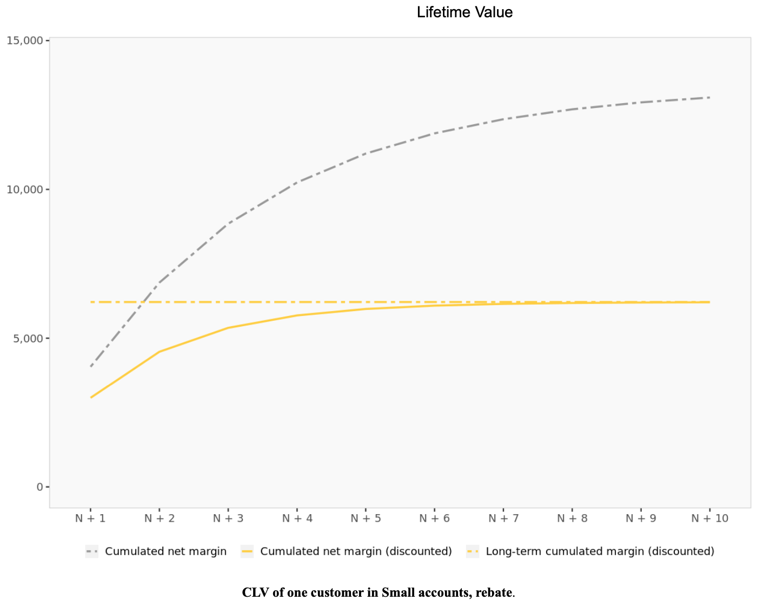
CLV of One Small Accounts w/ Rebates (10% vs 35% discount)
Notes:
Adrian

Slide 16
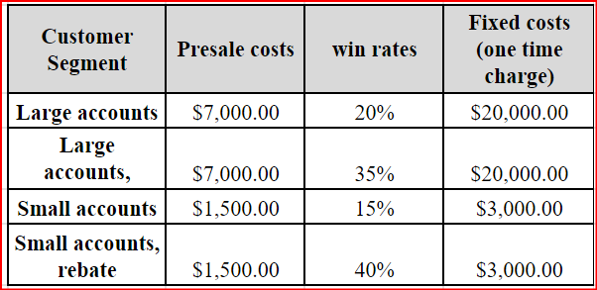
What About Acquisition Costs?
Notes:
EVAN:

Slide 17
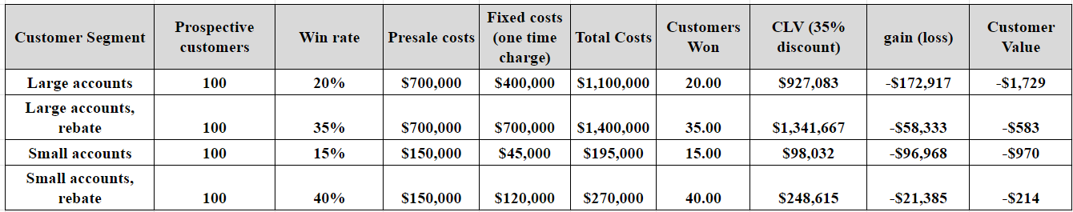
Acquisition Cost Model:
Assuming we 100 prospective customers per segment we modeled the following acquisitions:
Notes:
EVAN

Slide 18
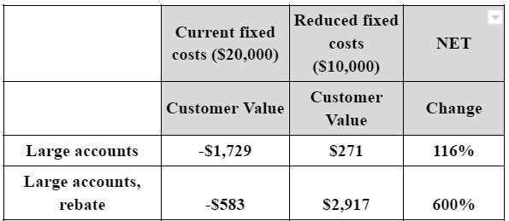
Recommendation
A reduction in Fixed costs for Large Accounts specifically provides an opportunity to increase Customer Value in the long term
Notes:
Evan

Slide 19
Recommendation
Customer Rebates provide an effective tool to retain customers in the long term
Syphone should focus on growing their rebate customer segments.
Notes:
Evan

Slide 20
Conclusion
Syphone's long-term customer relationships may have limited monetary value, with an increasing risk of customer attrition over time due to exponential loss rates.
Profits and growth are most significant during the initial three years, supported by higher gross margins and income. High acquisition costs limit long term profitability.
In the dynamic phone industry, prioritizing new customer acquisition through rebates and targeted marketing appears strategically advantageous over the retention of existing customers, as external factors can significantly impact the industry landscape.
Notes:
Evan

